Slide 1


Case #1—Stage IIIA NSCLC:
A Multidisciplinary
Treatment Approach
Part I
Paul Van Schil, MD, PhD
Antwerp University Hospital
Antwerp, Belgium
www.prIMEoncology.org

Slide 2

Management of Stage IIIA NSCLC by Thoracic Surgeons in North America
Web-based survey 513/2539 (20%) responded – 43% academic practice
Microscopic N2: 84% induction therapy + surgery
Grossly involved N2: 62% induction therapy + surgery (N2 downstaged)
Bulky, single station N2, normal lung function, initially pneumonectomy required: 32% induction + lobectomy (N2 downstaged)
30% induction + pneumonectomy (downstaged)
12% induction + surgery anyway
22% definitive chemoradiotherapy
Veeramachaneni NK, et al. Ann Thorac Surg. 2012;94(3):922-926.

Slide 3
Stage IIIA—N2 NSCLC
Surgery
Invasive staging of lung cancer
Restaging after induction therapy
Stage IIIA-N2: Role of surgery
  Conclusion

Slide 4
Stage IIIA—N2 NSCLC
Surgery
Invasive staging of lung cancer
Restaging after induction therapy
Stage IIIA-N2: Role of surgery
  Conclusion

Slide 5
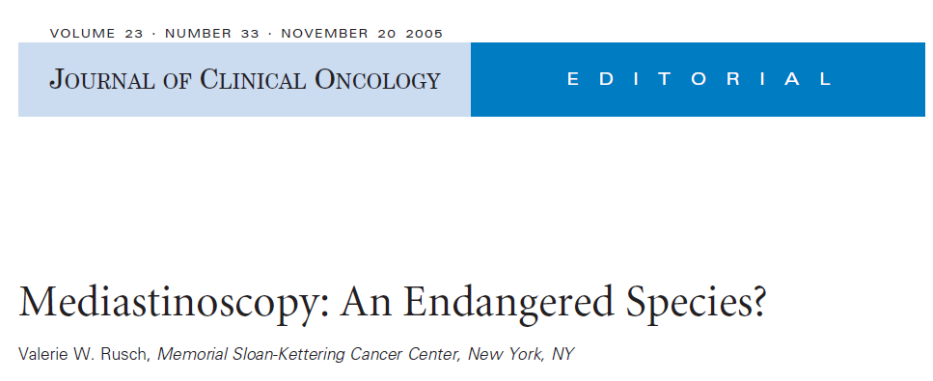

Rusch VW. J Clin Oncol. 2005;23(33):8283-8285

Slide 6
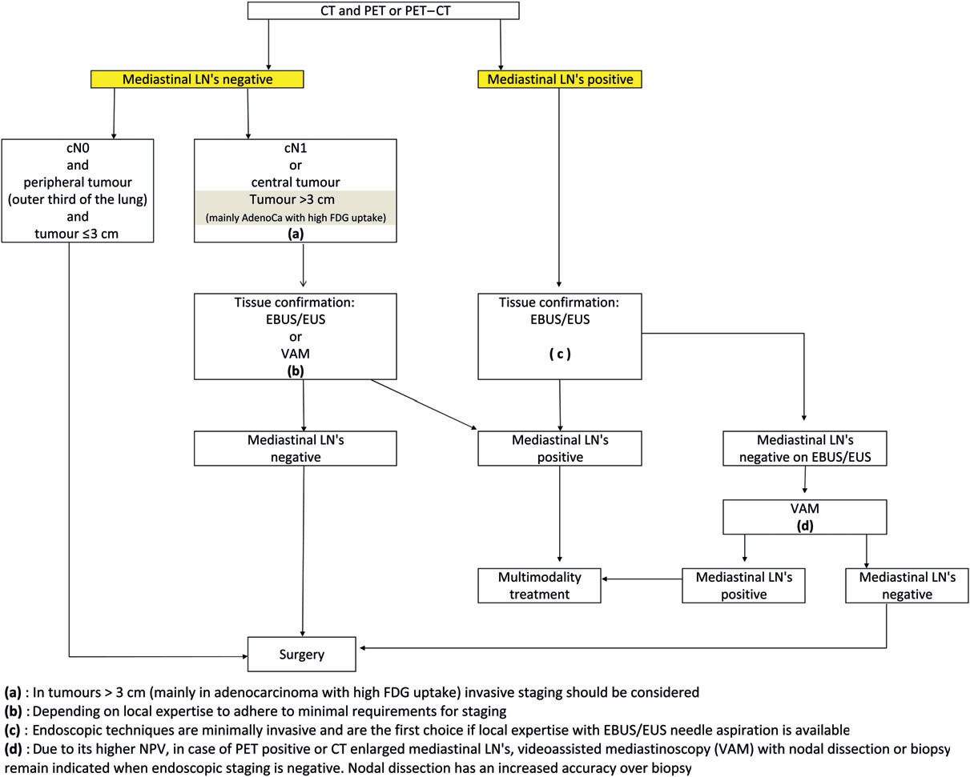
ESTS Guidelines for Preoperative Mediastinal Lymph Node Staging for NSCLC: PET Available
ESTS, European Society of Thoracic Surgeons; VAM, video-assisted mediastinoscopy
De Leyn P, et al. Eur J Cardiothorac Surg. 2014;45(5):787-798.

Slide 7
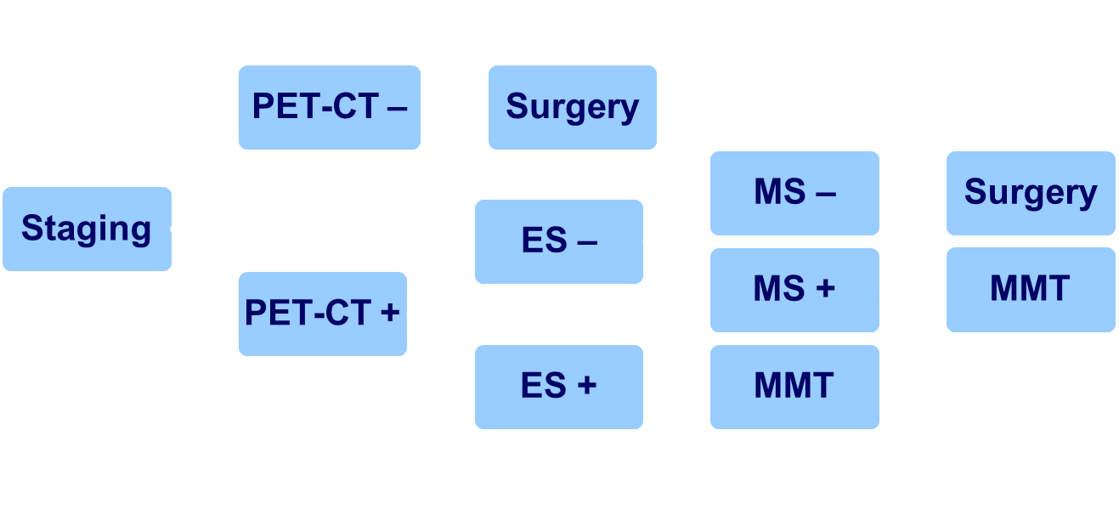
Staging Lung Cancer
Antwerp University Hospital
ES, endosonographic technique (EBUS-EUS); MS, mediastinoscopy; MMT, multimodality therapy

Slide 8
Stage IIIA—N2 NSCLC
Surgery
Invasive staging of lung cancer
Restaging after induction therapy
Stage IIIA-N2: Role of surgery
  Conclusion

Slide 9
Why Is Downstaging Important?
Prognostic factors after induction therapy
      Complete surgical resection
      Clearance mediastinal lymph nodes
Detterbeck FC, et al. Diagnosis and treatment of lung cancer. An evidence-based guide for the practicing clinician. Philadelphia, PA: WB Saunders Co. 2001; p 267-282.

Slide 10
Restaging After Induction Therapy:
Systematic Review
Systematic review: Reliability of restaging after induction therapy for stage IIIA-N2 NSCLC
Mediastinal node involvement
 | N | FN Rate (FN/TN+FN), % | FP Rate (FP/TP+FP), %
CT scan | 190 | 33 | 33
PET scan | 453 | 25 | 33
reMS | 515 | 22
EUS | 56 | 15 | Expert hands!
EBUS | 135 | Not enough data
Primary MS | 85 | 9 | Most accurate!
EBUS, endobronchial ultrasound; EUS, esophageal ultrasound and needle aspiration; FN, false negative; FP, false positive; MS, mediastinoscopy; reMS, repeat mediastinoscopy; TN, true negative; TP, true positive
de Cabanyes Candela S, et al. J Thorac Oncol. 2010;5(3):389-398.

Slide 11
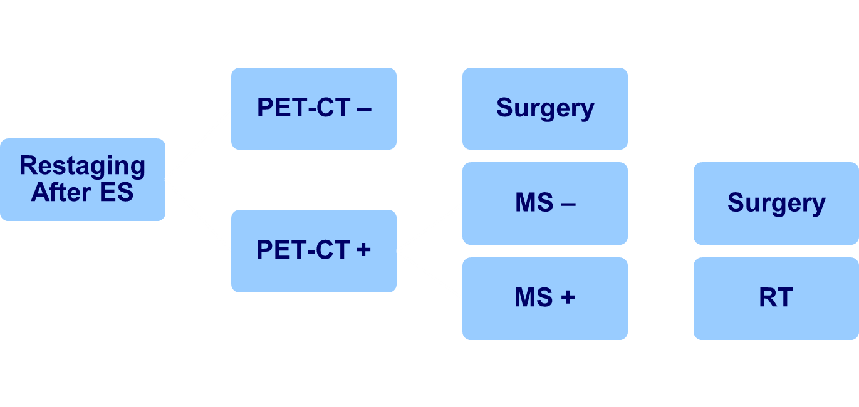
Restaging After Induction Therapy
Antwerp University Hospital

Slide 12
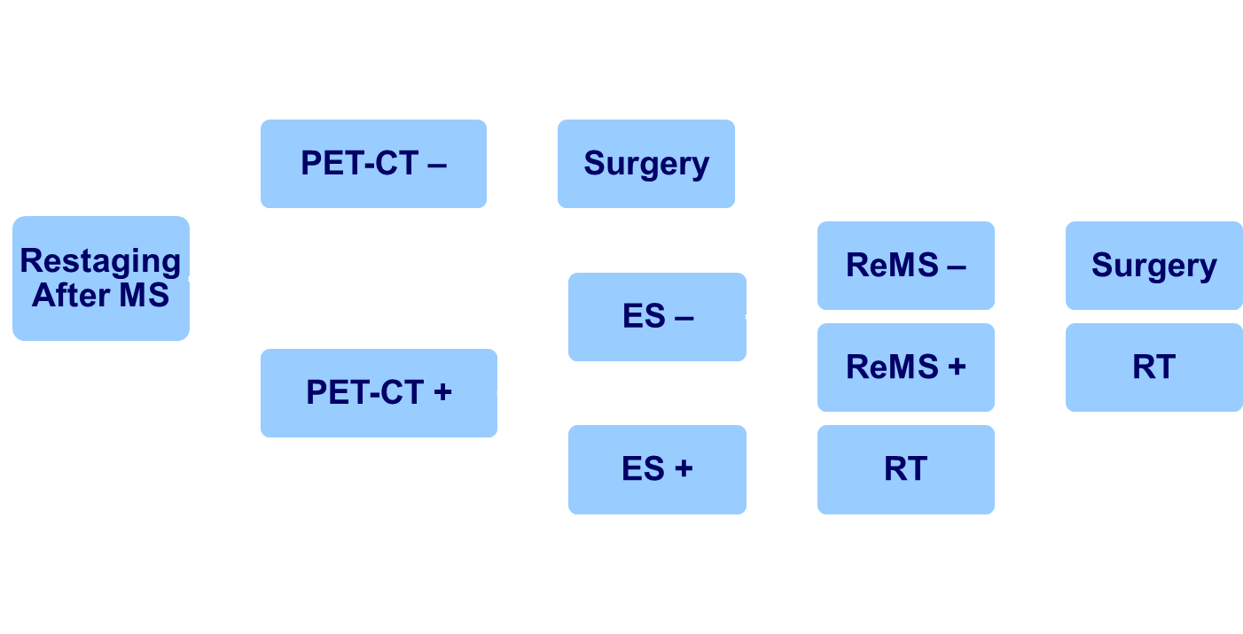
Restaging After Induction Therapy
Antwerp University Hospital

Slide 13
Stage IIIA—N2 NSCLC
Surgery
Invasive staging of lung cancer
Restaging after induction therapy
Stage IIIA-N2: Role of surgery
  Conclusion

Slide 14
IASLC: Complete Resection Subcommittee
Complete Resection R0
Free resection margins proved microscopically
Systematic or lobe-specific systematic nodal dissection:
  ≥6 nodal stations (3 mediastinal)
No extracapsular extension in nodes removed separately or at the margin of the lung specimen
Highest mediastinal lymph node must be negative
Rami-Porta R, et al. Lung Cancer. 2005;49(1):25-33.

Slide 15
Surgery for N2 Disease
Randomized Studies
EORTC 08941^{1,2}
  Stage IIIA-N2 NSCLC
  Phase III induction CT. In case of response, randomization between surgery and RT
    167 patients surgery
Intergroup trial 0139³
  Stage IIIA-N2 NSCLC
  Phase III concurrent CT/RT versus CT/RT induction + surgery
    164 patients surgery
1. Van Schil P, et al. Eur Respir J. 2005;26(2):192-197. 2. Van Meerbeeck JP, et al. J Natl Cancer Inst. 2007;99(6):442-453. 3. Albain KS, et al. Lancet. 2009;374(9687):379-386.

Slide 16
Comparison
EORTC 08941 – INT 0139
 | EORTC 08941^{1,2} |  | INT-139³
Induction therapy | Chemotherapy |  | Chemoradiotherapy
Complete resection definition ≠ | 50% |  | 71%
Expl. thoracotomy | 13.6% |  | 4.5%
ypN0/1/2 | N0/1 | 41.4% | N0/1 | 46%
 | N2 | 56% | N2 | 54%
ypT0N0 | 5.2% |  | 14.4%
1. Van Schil P, et al. Eur Respir J. 2005;26(2):192-197. 2. Van Meerbeeck JP, et al. J Natl Cancer Inst. 2007;99(6):442-453. 3. Albain KS, et al. Lancet. 2009;374(9687):379-386.

Slide 17
Comparison
EORTC 08941 – INT 0139
30-Day Mortality | EORTC 08941^{1,2} |  |  | INT-139³
Overall | 3.9% |  |  | 5%
Lobectomy | 0% |  |  | 1%
Pneumonectomy | 6.9% |  | 26%
 | R 5.3% L 9.1% |  | R Simple R Complex L Simple L Complex |  | 29% 50% 0% 16%
Expl. thoracotomy | 4.8% |  | 0%
90-day mortality | 8.4%
1. Van Schil P, et al. Eur Respir J. 2005;26(2):192-197. 2. Van Meerbeeck JP, et al. J Natl Cancer Inst. 2007;99(6):442-453. 3. Albain KS, et al. Lancet. 2009;374(9687):379-386.

Slide 18
Comparison
EORTC 08941 – INT 0139
5-Year Survival | EORTC 08941^{1,2} |  | INT 0139³
Lobectomy | 27% |  | 36%
Pneumonectomy | 12% |  | 22%
 | P = .009
ypN0/1/2 | N0/1 | 29% | N0 | 41%
 | N2/3 | 7% | N1-3 | 24%
 | P = .0009 |  | P<.0001
1. Van Schil P, et al. Eur Respir J. 2005;26(2):192-197. 2. Van Meerbeeck JP, et al. J Natl Cancer Inst. 2007;99(6):442-453. 3. Albain KS, et al. Lancet. 2009;374(9687):379-386.

Slide 19
EORTC 08941
Overall Survival in Randomized Patients
 | Radiotherapy n = 165 | Surgery n = 167
FU, median, months | 73 | 67
mOS, months, (95% CI) | 17.5 (15.8-23.2) | 16.4 (13.3-19.0)
5-year OS, % | 14 | 15.7
HR (95% CI) | 1 (referent) | 1.06 (0.84-1.35)
 | P = .60
100
80
crossing
60
FU, follow up; mOS, median overall survival; HR, hazard ratio
40
20
Surgery
Radiotherapy
0
months
12
24
36
48
60
72
84
96
108
Van Meerbeeck JP, et al. J Natl Cancer Inst. 2007;99(6):442-453.
Notes:
The overall survival in the randomized patients was calculated after a median follow up of more than 5 years. The median overall survival in the irradiated patients was 17.5 months and 16.4 months in the operated patients. Neither the two year nor the five-year actuarial survival rates were statistically significantly different: 5 y OS rates were 14 and 15.7% respectively with a hazard ratio of 1.06 and 95% CI of 0.84 to 1.35. The Kaplan-Meier survival curve overlaps and crosses at about 3 years.

Slide 20
Intergroup 0139 / RTOG 9309
Progression-Free Survival by Treatment Arms
100
crossing
 | Failed /Total
CT/RT/S | 159/202
CT/RT | 172/194
75
/
50
% Alive without Progression
/
/
/
/
/
25
/
/
/
/
/
/
/
/
/
/
/
/
/
/
Logrank P = .017
Hazard ratio = 0.77 (0.62, 0.96)
/
/
/
/
/
/
0
0
12
24
36
48
60
Months from Randomization
CT/RT/S, chemotherapy plus radiotherapy followed by surgery; CT/RT chemotherapy plus radiotherapy
Albain KS, et al. Lancet. 2009;374(9687):379-386.

Slide 21
INT 0139
Exploratory Survival Analysis
All but 1 postoperative death followed a pneumonectomy
Hypothesized survival advantage on CT/RT/S if lobectomy performed
Patients with lobectomy were completely matched with patients on CT/RT arm on 4 prestudy factors:
  KPS, age, sex, T stage
  Feasible for n = 90/98
KPS, kanorfsky performance status
Albain KS, et al. Lancet. 2009;374(9687):379-386.

Slide 22
INT0139 Overall Survival of the Lobectomy Subset vs Matched CT/RT Subset
100
 | Dead / Total
CT/RT/S | 57 / 90
CT/RT | 74 / 90
75
no crossing!
Logrank P = .002
50
/
/
/
% Alive
/
/
/
/
/
/
/
/
/
/
/
/
/
25
/
/
 | CT/RT/S | CT/RT
mOS, months | 33.6 | 21.7
5-year OS, % | 36 | 18
/
/
/
/
/
0
0
12
24
36
48
60
Months From Randomization
Albain KS, et al. Lancet. 2009;374(9687):379-386.

Slide 23
EORTC – INT Trials
Lessons Learned
Persistent ypN2 disease after induction therapy:
Poor prognosis
ypN2 marker of systemic disease ≈ 50 % in both INT and EORTC trials → ↓survival
Focus on pathologic restaging of mediastinum (EBUS, EUS, remediastinoscopy)
  Surgery probably beneficial; in case of mediastinal downstaging – lobectomy, complete resection

Slide 24
Stage IIIA—N2 NSCLC
Surgery
Invasive staging of lung cancer
Restaging after induction therapy
Stage IIIA-N2: Role of surgery
  Conclusion

Slide 25
Restaging in Stage IIIA-N2 NSCLC
Why?
Persisting mediastinal involvement after induction therapy: Poor prognosis
Downstaging is significant prognostic factor!
How?
  Noninvasive methods: CT, MRI unreliable
  PET: FP and FN cases, metastases
  Invasive methods: reMS feasible, ↓ accuracy than 1stMS
  VATS feasible, to be explored further
  Alternative methods: TBNA
  EUS EBUS
  TTNA
Under investigation, ↑FN rate
Focus on single LN: Complete exploration?
FP, false positive; FN, false negative; reMS, repeat mediastinoscopy; 1stMS, primary mediastinoscopy; VATS, Video-assisted thoracoscopic surgery; EUS, esophageal ultrasound; TBNA, transbronchial needle aspiration; EBUS, endobronchial ultrasound; TTNA, ransthoracic needle aspiration

Slide 26
Surgery Stage IIIA-N2 NSCLC
Surprise, unexpected N2: Complete resection, adjuvant chemo ± radiotherapy
Potentially resectable N2 (discrete mediastinal node involvement): Induction therapy, downstaging, lobectomy
American College of Chest Physicians Evidence-Based Clinical Practice Guidelines.
Ramnath N, et al. Chest. 2013;143 (5 suppl):e314S-e40S.
“Neoadjuvant therapy followed by surgery is neither clearly better nor clearly worse than definitive chemoradiation” “Weak comparative data suggest a possible role if only lobectomy is needed in a center with low perioperative †”
→ Final goal = complete resection, irrespective of stage

